Slide 1
Software Architecture Design
Architectural Styles
Architectural Design
Architectural Mapping

Slide 2



Why Architecture?
Architecture of a system describes the components and how they fit together.
Architecture enables a software engineer to:
analyze the effectiveness of the design in meeting its stated requirements,
consider architectural alternatives at a stage when making design changes is still relatively easy, and
reduce the risks associated with the construction of the software.

Slide 3
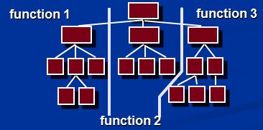
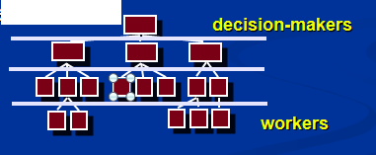
Horizontal & Vertical Partitioning
Horizontal Partitioning define separate branches of the module hierarchy for each major function
This use control modules to coordinate communication between functions
Vertical Partitioning: Factoring
Vertical partitioning suggests the control and work should be distributed in top-down fashion in the program structure.
The decision making modules should reside at the top of the architecture

Slide 4





Architectural Styles
The architectural styles is used to describes a system which has :
set of components (e.g., a database, computational modules) that perform a function required by a system,
set of connectors that enable “communication, coordination and cooperation” among components,
constraints that define how components can be integrated to form the system, and
semantic models that enable a designer to understand the overall properties of a system by analyzing the known properties of its constituent parts.

Slide 5
Taxonomy of Styles in Software architecture
Data-centered architectures
  There is a central data server which is accessed by clients
Data flow architectures
  Data travels through a series of components
Call and return architectures
  Classical architecture
Object-oriented architectures
  Modern style. Components pass messages
Layered architectures
  High-level to machine level architecture

Slide 6
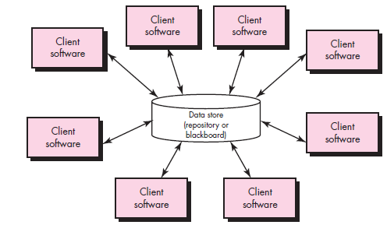
Data-Centered Architecture

Slide 7
Data-Centered Architecture
A data store (e.g., a file or database) resides at the center of this architecture and is accessed frequently by other components that add, delete, modify or update data within the store.
The main goal is to integrate the data
The shared data may be a passive repository or an active blackboard
Passive repository means the client software accesses the data independent of any changes to the data or the actions of other client software.
A variation on this approach transforms the repository into a “blackboard”
  A blackboard notifies subscriber clients when changes occur in data of its interest

Slide 8
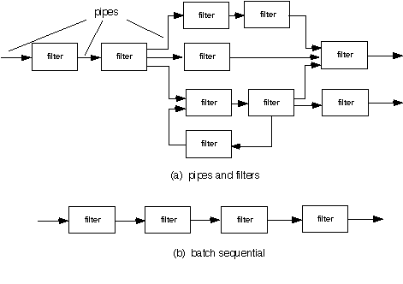
Data Flow Architecture
This architecture is used when input has to be transformed into output through a series of computational components.
The main goal is modifiability
Pipe-and-filter style
  A pipe-and-filter pattern has a set of components, called filters, connected by pipes that transmit data from one component to the next.
  The filters incrementally transform the data
  The filter does not require knowledge of the workings of its neighboring filters.
Batch sequential style
  If the data flow degenerates into a single line of transforms, it is termed batch sequential.
  This structure accepts a batch of data and then applies a series of sequential components (filters) to transform it.

Slide 9
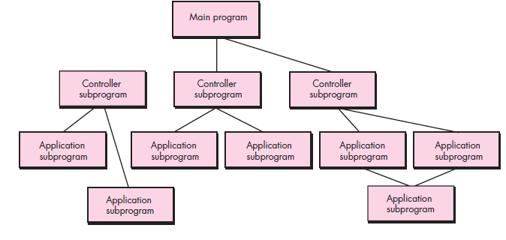
Call and Return Architecture
This architectural style enables to achieve a program structure that is relatively easy to modify and scale
Substyles of call and return architecture:
Main program/subprogram architectures
This style decomposes the function into a control hierarchy where a main program invokes a number of program components which in turn may invoke other components.
Remote procedure call architectures
The components of a main program/subprogram architecture are distributed across multiple computers on a network.

Slide 10
Object-oriented architectures
The components of a system encapsulate data and the operations that are applied to manipulate the data.
Communication between components are accomplished through message passing.

Slide 11
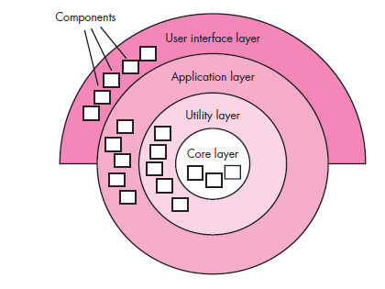
Layered Architecture
A number of different layers are defined, each accomplishing operations that progressively become closer to the machine instruction set.
At the outer layer, components service user interface operations.
At the inner layer, components perform operating system interfacing.
Intermediate layers provide utility services and application software functions.

Slide 12
ARCHITECTURAL DESIGN PROCESS
Architectural Design Steps
Represent the system in context
Define archetypes
Refine the architecture into components
Describe instantiations of the system

Slide 13
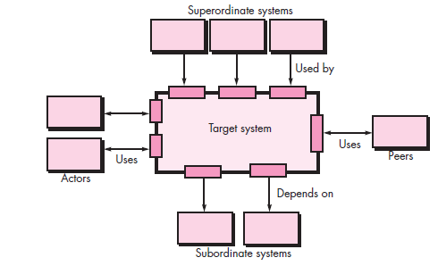
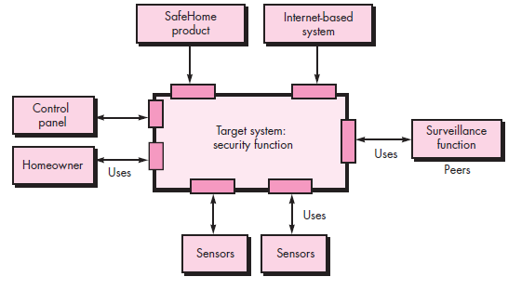
1. Represent the System in Context

Slide 14
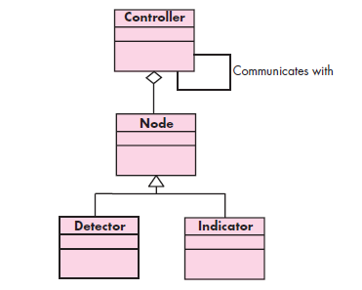
2. Define Archetypes

Slide 15
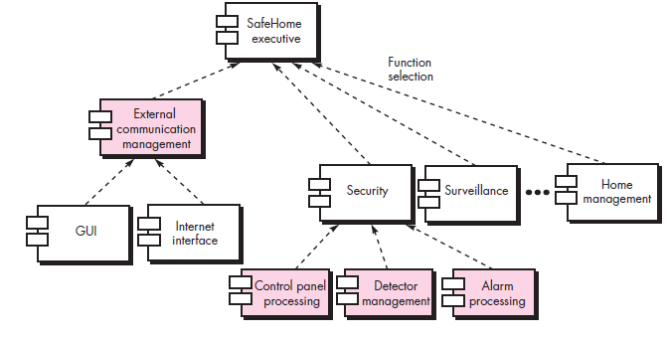
3. Refine the Architecture into Components

Slide 16
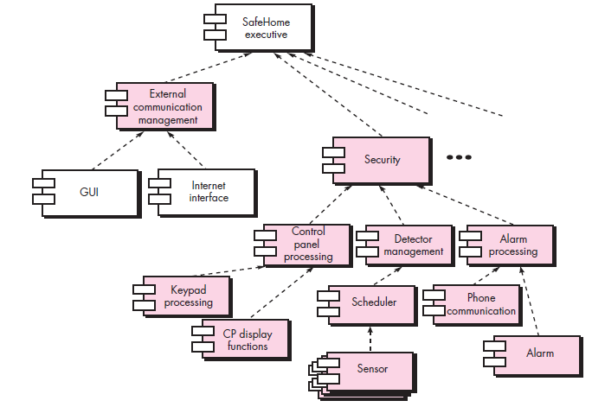
4. Describe Instantiations of the System

Slide 17
Architectural Mapping
Structured design provides a convenient transition from a data flow diagram to software Architecture
Types of information flow
The 2 different types of information flows:
Transaction flow - a single data item triggers information flow along one of many paths
Transform flow
overall data flow is sequential and flows along on a small number of straight-line paths
  Incoming Flow: The paths that transform the external data into an internal form
  Transform Center: The incoming data are passed through a transform center and begin to move along paths that lead it out of the software
  Outgoing Flow: The paths that move the data out of the software

Slide 18
Steps Involved
Step 1. Review the fundamental system model.
Step 2. Review and refine data flow diagrams for the software.
Step 3. Determine whether DFD has transform or transaction flow characteristics
Step 4. Isolate the transform center by specifying incoming and outgoing flow boundaries
Step 5. Perform “first-level factoring”
Step 6. Perform “second-level factoring”
Step 7. Refine the first iteration program structure using design heuristic

Slide 19
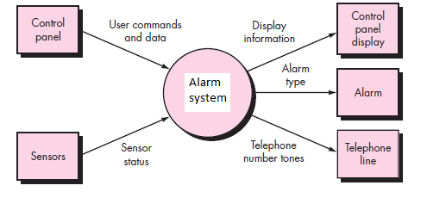
Step 1. Review the fundamental system model.
SAFE HOME PROJECT

Slide 20
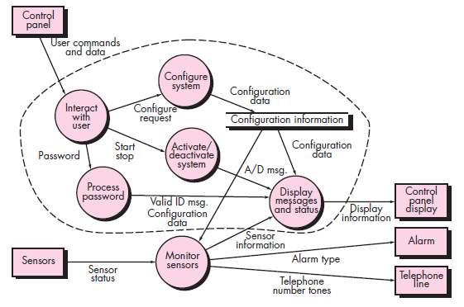
Step 2. Review and refine data flow diagrams for the software.

Slide 21
Step 3. Determine whether DFD has transform or transaction flow characteristics.
    in general---transform flow
    special case---transaction flow

Slide 22
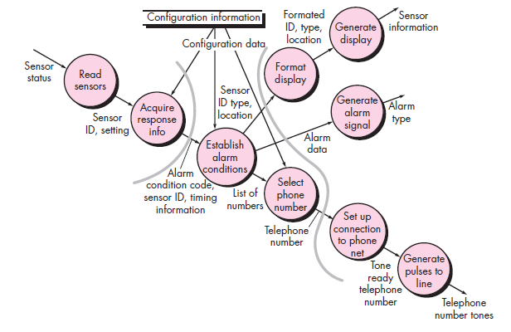
Step 4. Isolate the transform center by specifying incoming and outgoing flow boundaries

Slide 23
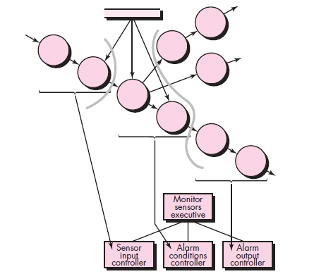
Step 5. Perform “first-level factoring”

Slide 24
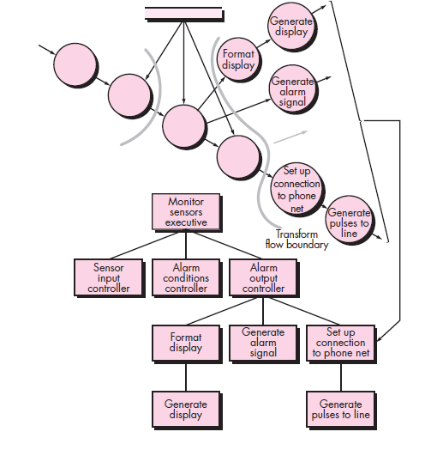
Step 6. Perform “second-level factoring”

Slide 25
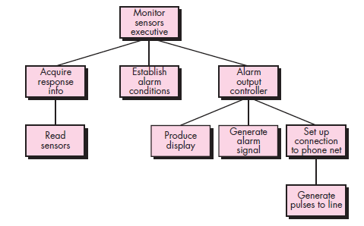
Step 7: Refine the first iteration program structure using design heuristics

